Slide 1

Vignan’s Institute of Management and Technology for Women
Department of CSE(AI&ML)
Fire Fighting Robot Using Arduino with Call and SMS Alert
Under the guidance of
B.Sangeetha
Assistant Professor
D.Likhitha MahaLaxmi (20UP1A6611)
G.Shravani (20UP1A6614)
M.Shruthi (20UP1A6632)
M.Sreeja (21UP5A6602)

Slide 2
ABSTRACT
The Arduino-based fire-fighting robot with SMS alert is aimed at developing an autonomous robot capable of detecting and extinguishing fires in indoor environments.
This project integrates a GSM module to send real-time SMS alerts to designated phone numbers, ensuring timely notification of fire incidents. By utilizing Arduino Uno, along with components like fire sensors, motor drivers, and a water sprinkler, the robot provides an efficient solution for fire safety.
This project contributes to the field of fire safety by integrating advanced technologies to create a dependable and self-directed system for fire detection, suppression, and real-time communication.

Slide 3
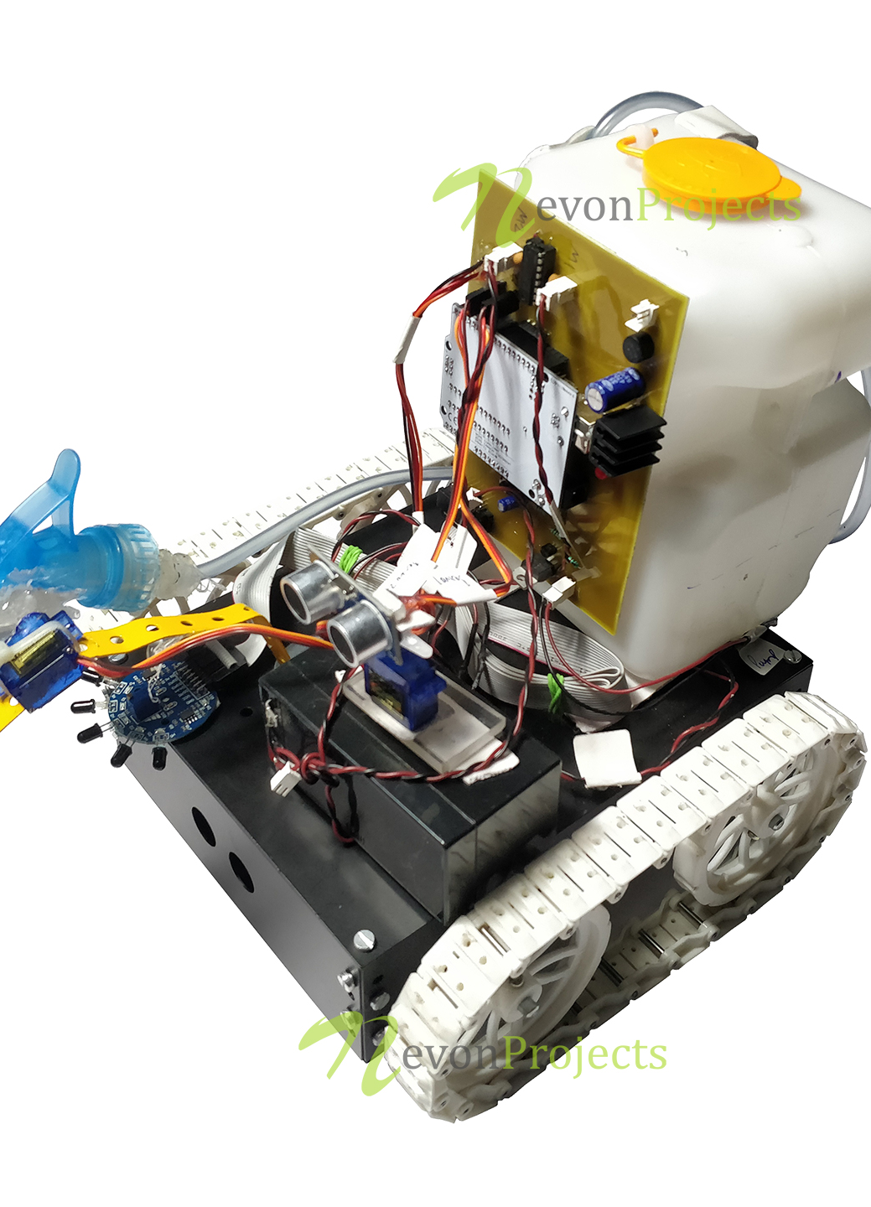
INTRODUCTION
What is a Fire Fighting Robot?
A firefighting robot is a specialized robot designed to assist firefighters in extinguishing fires and performing tasks in hazardous environments.
These robots are equipped with various sensors, cameras, and tools to navigate through smoke-filled areas and assess the situation.
They can be remotely operated or autonomous, depending on their design.

Slide 4
Objectives of Fire Fighting Robot
Develop an autonomous fire-fighting robot for indoor environments.
Implement a fire suppression mechanism for efficient extinguishing.
Integrate a GSM module for real-time SMS alerts.
Enhance fire safety and response efficiency through automation.
Utilize Arduino Uno for control and programming flexibility.
Allow customization and future expansion.

Slide 5

EXISTING SYSTEM OF FIRE FIGHTING ROBOT
The common conventional firefighting methods involve fire brigades, portable fire extinguisher (hand held) and sprinklers.
These conventional methods consume lot of time to reach the place of the mishap like the fire brigade must be deployed from the fire station and should get through the traffic and reach the fire struck area, the portable extinguisher is also no gift because it is generally place at one off the corners of the building which may be difficult to reach and it needs constant maintenance.
On the other hand the sprinkler and smoke detector set up is very non reliable method because the sprinkler pipes has any defect may not provide enough pressure and it is not suited to cover large areas.

Slide 6
LIMITATIONS AND GAPS
The problem with existing system is that exposure to the hazardous and chaotic fire environment, rather than to the fire itself, is the most significant cause of injury and death in fires.
The reachability of precise information in real-time on the conditions directly at the center of the fire ground is a crucial factor in the guidance of rescue actions together with feasible counter-plans.
Unfortunately the firefighting environments are normally hard to reach and restricted inaccessibility by obstacles, tumbledown architectures and visibility by smoke, dangerous gases or dust.
Therefore, the fire scene is an information-poor environment due to lack of information on location of fire, firefighters and victims, and the search and rescue opportunities are previously unimaginable due to lack of situational conditions and real-time information for targeted decision making to this the accidents occurs.
Additionally, the current methods applied in firefighting are inadequate and inefficient relying heavily on humans who are prone to error, no matter how extensively they have been trained.

Slide 7
PROPOSED SYSTEM
Components Required
The proposed model is able to detect presence of fire using flame sensor and calculates object distance using ultrasonic sensor and moves the robot to fire accident location.
It contains gear motors and motor driver to control the movement of robot.
When it detects fire it communicates with microcontroller (Arduino MEGA) and the robot will move towards the fire affected area.
The fire extinguisher is mounted on the robotic vehicle which is then controlled over the wireless communication so that it extinguishes the fire automatically.
Arduino MEGA
Fire Sensors
Motor Drivers
Motors and Wheels
Water Sprinklers or Extinguishing Mechanism
GSM Module
Power Supply

Slide 8
Advantages of Fire Fighting Robot
The robot will be used at places where it is dangerous for humans to enter.
Capability of sensing accurately with increased flexibility.
Reduce human effort.
Reliable and economical.
It reduces the time delay in reaching fire affected area.
It reduce the errors and the limitations that are faced by human fire fighters.
Sensors have long life time and less cost.

Slide 9
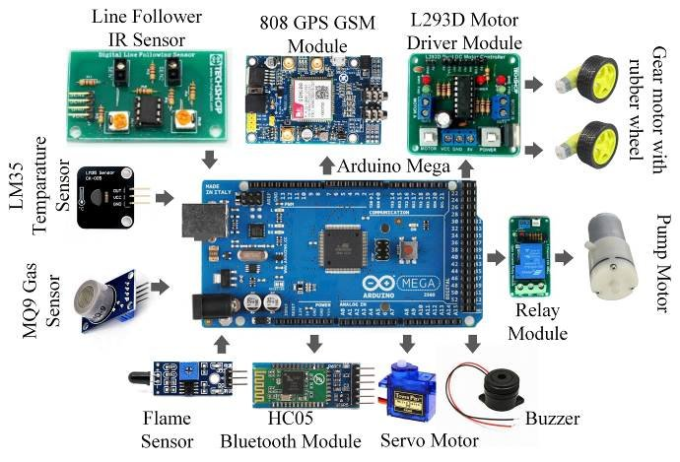

Slide 10
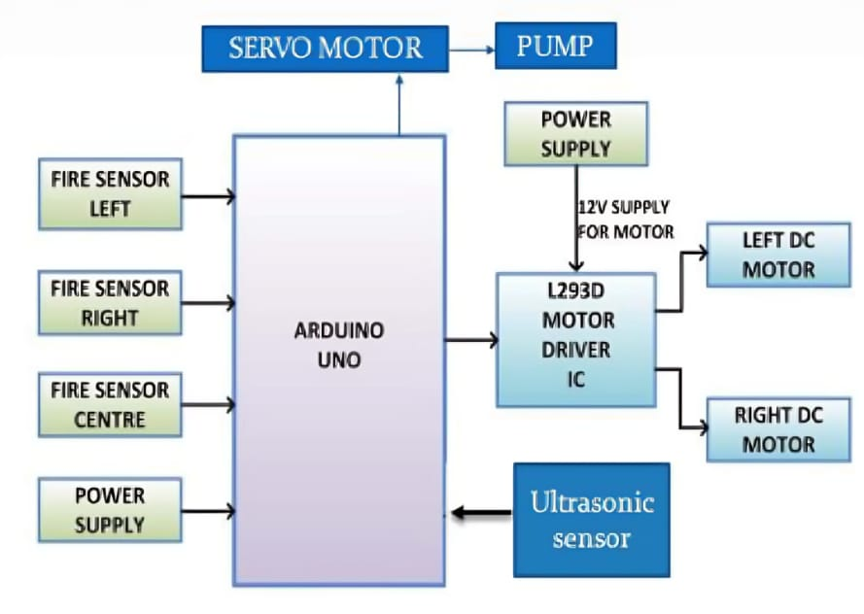
ARCHITECTURE

Slide 11
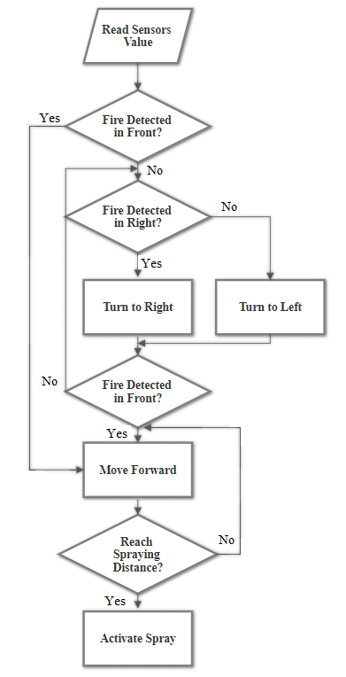
IMPLEMENTATION
The Robot continuously monitors variation of the surrounding area using flame sensors.
Sensor ready to sense the fire signal.
If fire is detected it will send signal to microcontroller to start water sprinkler.
Robot will keep on moving until fire is detected.
If fire is not detected robot will stop and be ready to receive the new signal.

Slide 12
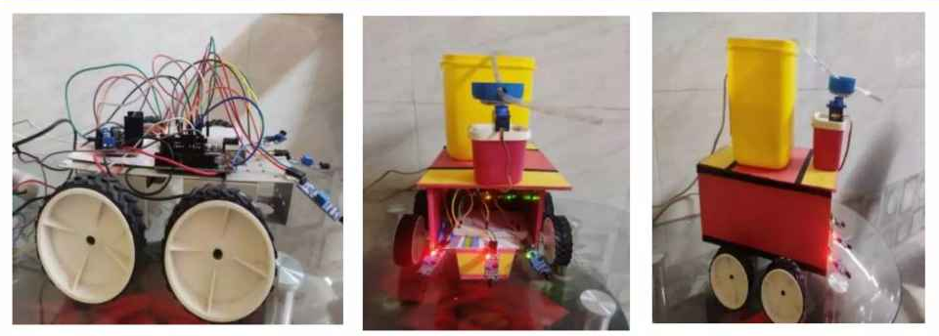
RESULTS AND DISCUSSION
In the 1st Phase, we have completed basic connection of Arduino UNO, Motor Driver and three flame sensors using jumper wires.
In the 2nd Phase, we have connected servo motor with water pump to extinguish fire.

Slide 13
FUTURE SCOPE
There are several potential future enhancements that could be made to Arduino based fire fighting robots:
Enhanced Sensing Technologies
Intelligent Path Planning
Wireless Communication
Fire Analytics and Prediction
Autonomous Recharging and Maintenance
Collaboration with Emergency Services
Integration with Building Systems
Environmental Adaptability

Slide 14
CONCLUSION
The Arduino-based fire-fighting robot with SMS alert project presents an innovative solution for enhancing fire safety in indoor environments.
By integrating autonomous fire detection, navigation, fire suppression mechanisms, and real-time SMS alerts, the robot improves response time and minimizes risks associated with fire incidents.
The project demonstrates the potential of Arduino Uno and GSM module integration, providing a reliable and adaptable system for fire emergency management.
Overall, the fire-fighting robot with SMS alert project contributes to the field of fire safety by providing an efficient and proactive approach to detecting and suppressing fires.

Slide 15
REFERENCES
1. Tawfiqur Rakib, M. A. Rashid Sarkar, “Design and fabrication of an autonomous
firefighting robot with multi sensor fire detection using PID controller”, ICIEV Volumn
23 issue-1 JUNE 2016.
2. Saravanan P. , Soni Ishawarya, “Android controlled intergrated semi-autonomous
firefighting robot”,Ineternational journal of innovative science Engg. And Technology
2015.
3. S. Jakthi Priyanka,R. Sangeetha, “Android controlled firefighting robot”, international
journal of innovative science Engg. and Technology ,Volumn 3, 2017.
4. Nagesh MS, Deepika T V , Stafford Michahial, Dr M Shivakumar, “Fire Extinguishing
Robot”, International Journal of Advanced Research in Computer and Communication
Engineering,Vol. 5, Issue 12, December 2016

Slide 16


